Slide 1




SOAR: A Synthesis Approach for Data Science API Refactoring
Ansong Ni* Daniel Ramos* Aidan Yang
Ines Lynce Vasco Manquinho
Ruben Martins Claire Le Goues

Slide 2

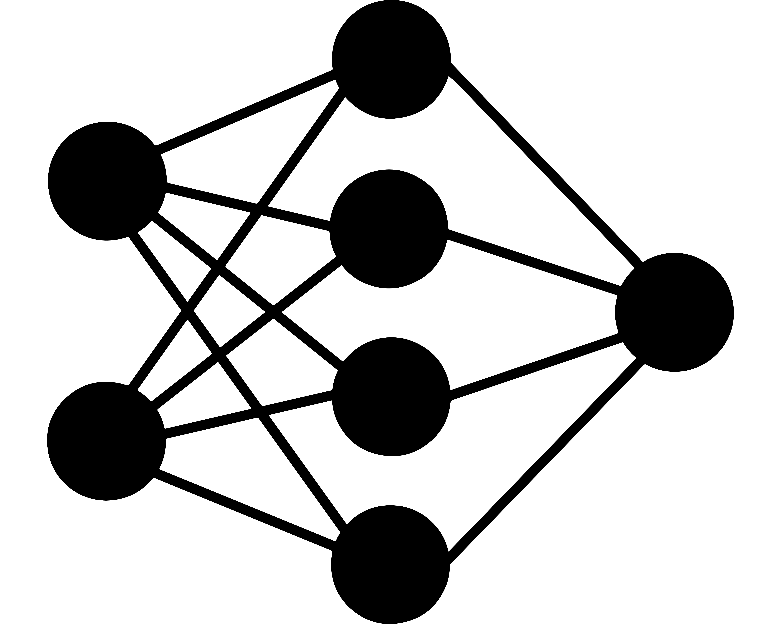



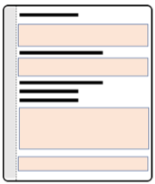

Motivation
Wants to create
a speech recognition
system
————————————
————————————————-
——————————————————
———————————————
——————————————————
————————————————-
——————————
———————————————
——————————————————
————————————————-
——————————————————
———————————————
——————————————————
————————————————-
——————————
———————————————
Speech
Machine Learning
Text
Test
Cases
Alex
Writes TF code
24/05/2021
SOAR: A Synthesis Approach for Open-Source API Refactoring

Slide 3
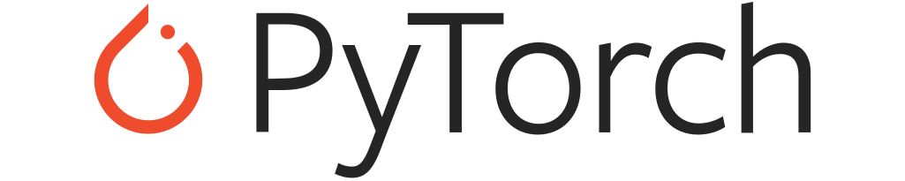
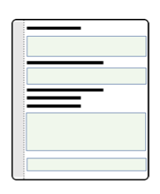
Alex wants to replace TensorFlow with PyTorch
Wants to create
a speech recognition
system
————————————
————————————————-
——————————————————
———————————————
——————————————————
————————————————-
——————————
———————————————
——————————————————
————————————————-
——————————————————
———————————————
——————————————————
————————————————-
——————————
———————————————
Speech
Machine Learning
Text
Test
Cases
Alex
Writes TF code
24/05/2021
SOAR: A Synthesis Approach for Open-Source API Refactoring

Slide 4
Does Alex have to start from scratch?
Wants to create
a speech recognition
system
————————————
————————————————-
——————————————————
———————————————
——————————————————
————————————————-
——————————
———————————————
——————————————————
————————————————-
——————————————————
———————————————
——————————————————
————————————————-
——————————
———————————————
?
Speech
?
Machine Learning
Text
?
Test
Cases
Alex
Writes TF code
24/05/2021
SOAR: A Synthesis Approach for Open-Source API Refactoring

Slide 5
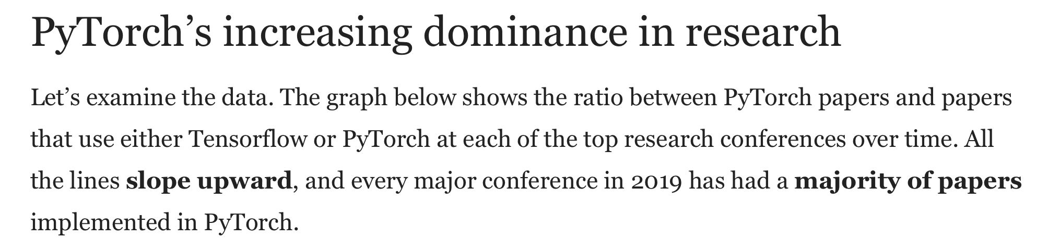
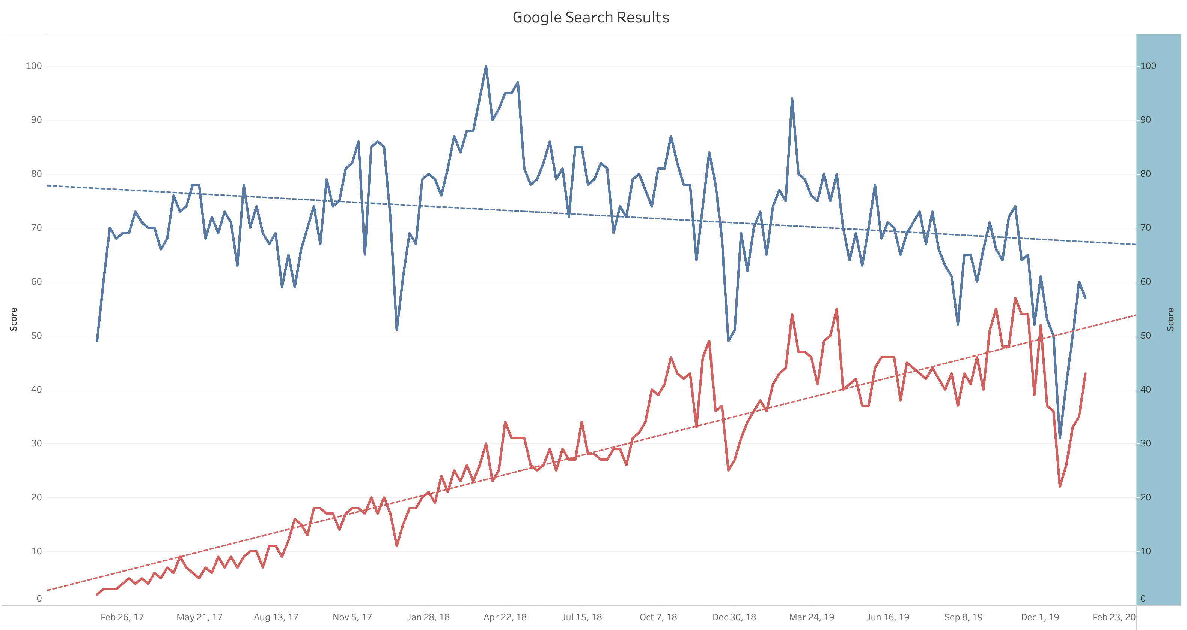
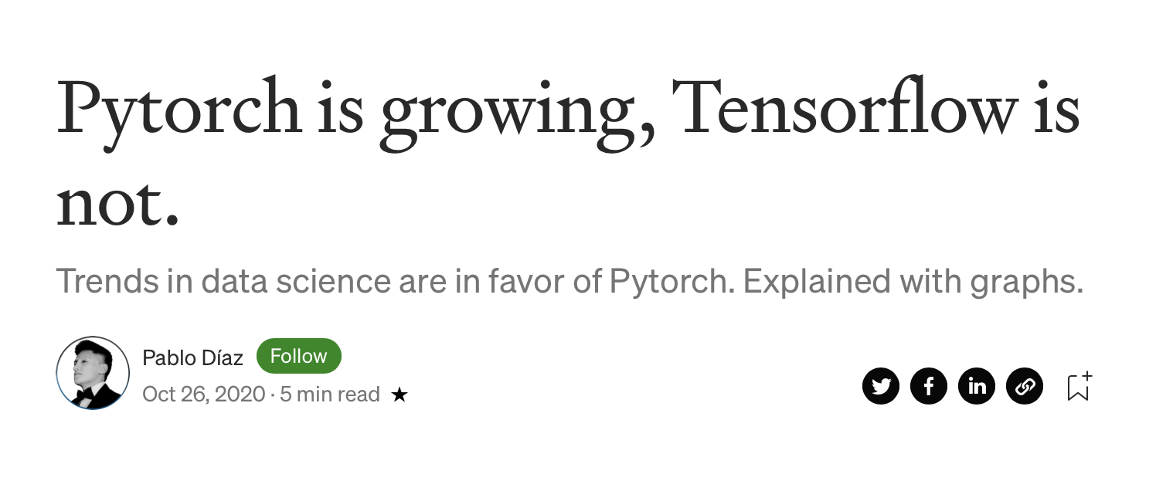
API migration problem
This is an API refactoring / migration problem
Libraries stop being supported, new alternatives emerge, etc.
TensorFlow
PyTorch
24/05/2021
SOAR: A Synthesis Approach for Open-Source API Refactoring

Slide 6
SOAR: A Synthesis Approach for API Refactoring
SOAR’s an end-to-end technique for API migration
import tensorflow as tf
class TensorLin(tf.keras.Model):
def __init__(self, **kwargs):
super(TensorLin, self).__init__()
self.fc1 = tf.keras.layers.Dense(128)
self.fc2 = tf.keras.layers.Dense(256)
self.out = tf.keras.layers.Dense(10)
def call(self, x):
x = self.fc1(x)
x = self.fc2(x)
x = self.out(x)
return x
import torch
class TorchLin(torch.nn.Module):
def __init__(self, **kwargs):
super(TorchLin, self).__init__()
self.fc1 = torch.nn.Linear(50,128)
self.fc2 = torch.nn.Linear(128,256)
self.out = torch.nn.Linear(256,10)
def forward(self, x):
x = self.fc1(x)
x = self.fc2(x)
x = self.out(x)
return x
Source (TF)
Target (Torch)
24/05/2021
SOAR: A Synthesis Approach for Open-Source API Refactoring

Slide 7
SOAR: A Synthesis Approach for API Refactoring
SOAR is built upon three key observations:
Data science APIs are well documented
24/05/2021
SOAR: A Synthesis Approach for Open-Source API Refactoring

Slide 9
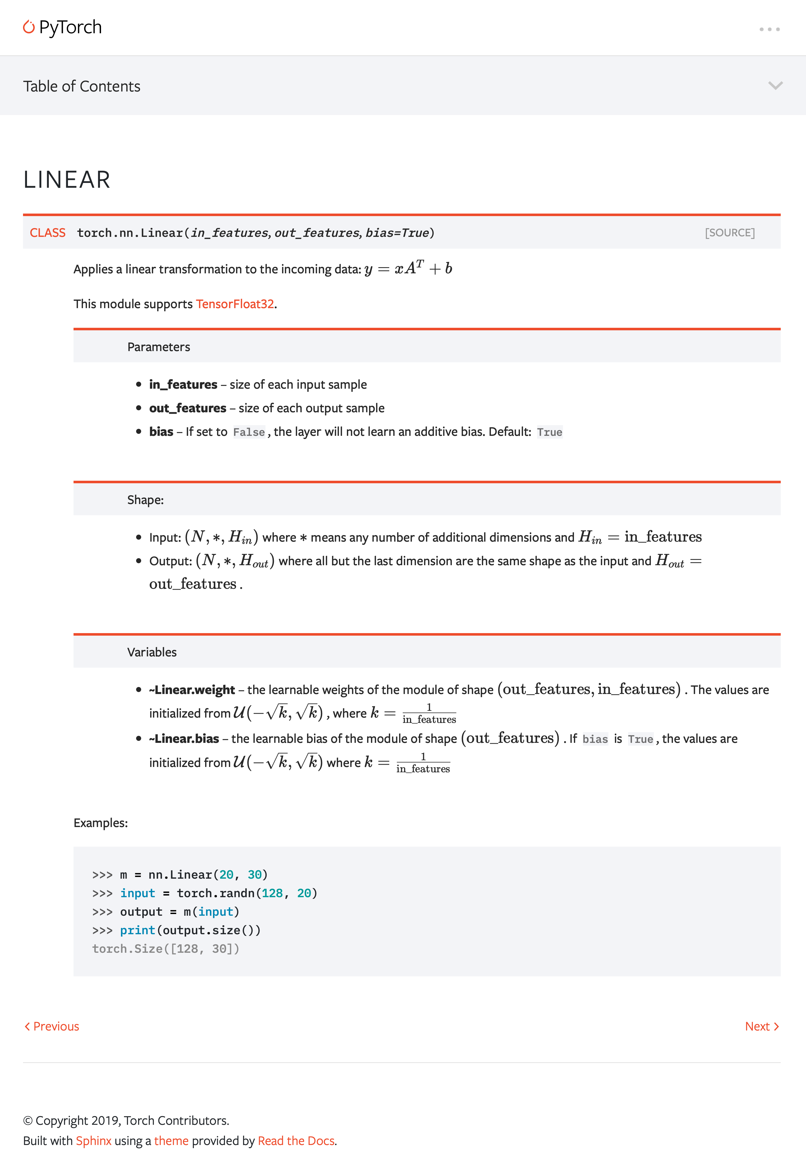

Slide 10

SOAR: API Mappings
SOAR is built upon three key observations:
Data science APIs are well documented
SOAR uses documentation to create API rankings
Source API | Target API
tf.keras.layers.Dense | torch.nn.Linear
tf.keras.layers.Conv2D | torch.nn.Conv2d
tf.reshape | torch.Tensor.view
24/05/2021
SOAR: A Synthesis Approach for Open-Source API Refactoring

Slide 11
SOAR: API Mappings
Using the mappings we can replace the source APIs
import tensorflow as tf
class TensorLin(tf.keras.Model):
def __init__(self, **kwargs):
super(TensorLin, self).__init__()
self.fc1 = tf.keras.layers.Dense(128)
self.fc2 = tf.keras.layers.Dense(256)
self.out = tf.keras.layers.Dense(10)
def call(self, x):
x = self.fc1(x)
x = self.fc2(x)
x = self.out(x)
return x
import torch
class TorchLin(torch.nn.Module):
def __init__(self, **kwargs):
super(TorchLin, self).__init__()
self.fc1 = torch.nn.Linear(?, ?)
self.fc2 = torch.nn.Linear(?, ?)
self.out = torch.nn.Linear(?, ?)
def forward(self, x):
x = self.fc1(x)
x = self.fc2(x)
x = self.out(x)
return x
24/05/2021
SOAR: A Synthesis Approach for Open-Source API Refactoring

Slide 12
API mappings say nothing about the new arguments
How can we compute the new arguments?
import tensorflow as tf
class TensorLin(tf.keras.Model):
def __init__(self, **kwargs):
super(TensorLin, self).__init__()
self.fc1 = tf.keras.layers.Dense(128)
self.fc2 = tf.keras.layers.Dense(256)
self.out = tf.keras.layers.Dense(10)
def call(self, x):
x = self.fc1(x)
x = self.fc2(x)
x = self.out(x)
return x
import torch
class TorchLin(torch.nn.Module):
def __init__(self, **kwargs):
super(TorchLin, self).__init__()
self.fc1 = torch.nn.Linear(?, ?)
self.fc2 = torch.nn.Linear(?, ?)
self.out = torch.nn.Linear(?, ?)
def forward(self, x):
x = self.fc1(x)
x = self.fc2(x)
x = self.out(x)
return x
24/05/2021
SOAR: A Synthesis Approach for Open-Source API Refactoring

Slide 13
SOAR: A Synthesis Approach for API Refactoring
SOAR is built upon three key observations:
Data science APIs are really well documented
Computing arguments is a great fit for program synthesis
24/05/2021
SOAR: A Synthesis Approach for Open-Source API Refactoring

Slide 14
SOAR: Program Synthesis
Documentation has information about argument types, constraints
Enumerate possible values and validate
import torch
class TorchLin(torch.nn.Module):
def __init__(self, **kwargs):
super(TorchLin, self).__init__()
self.fc1 = torch.nn.Linear(int: x1, int: x2)
self.fc2 = torch.nn.Linear(int: x3, int: x4)
self.out = torch.nn.Linear(int: x5, int: x5)
def forward(self, x):
x = self.fc1(x)
x = self.fc2(x)
x = self.out(x)
return x
24/05/2021
SOAR: A Synthesis Approach for Open-Source API Refactoring

Slide 15
SOAR: Program Synthesis
Documentation has information about argument types, constraints
Enumerate possible values and validate
import torch
class TorchLin(torch.nn.Module):
def __init__(self, **kwargs):
super(TorchLin, self).__init__()
self.fc1 = torch.nn.Linear(int: x1, int: x2)
self.fc2 = torch.nn.Linear(int: x3, int: x4)
self.out = torch.nn.Linear(int: x5, int: x5)
def forward(self, x):
x = self.fc1(x)
x = self.fc2(x)
x = self.out(x)
return x
x1 = -1 & x2 = 256
x1 = 50 & x2 = -1
x1 = 50 & x2 = 128
24/05/2021
SOAR: A Synthesis Approach for Open-Source API Refactoring

Slide 16
SOAR: A Synthesis Approach for API Refactoring
SOAR is built upon three key observations:
Data science APIs are really well documented
Computing arguments is a great fit for program synthesis
SOAR uses documentation to guide the synthesis
24/05/2021
SOAR: A Synthesis Approach for Open-Source API Refactoring

Slide 17
SOAR: A Synthesis Approach for API Refactoring
SOAR is built upon three key observations:
Data science APIs are really well documented
Computing arguments is a great fit for program synthesis
Well-documented APIs have informative error messages
24/05/2021
SOAR: A Synthesis Approach for Open-Source API Refactoring

Slide 18

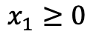
SOAR: Error Message Understanding
SOAR uses error messages to speed-up the synthesis process
Generates constraints from the errors to prune the search space
torch.nn.Linear(-1, 50)
$$x_{1}≥0$$
24/05/2021
SOAR: A Synthesis Approach for Open-Source API Refactoring

Slide 19
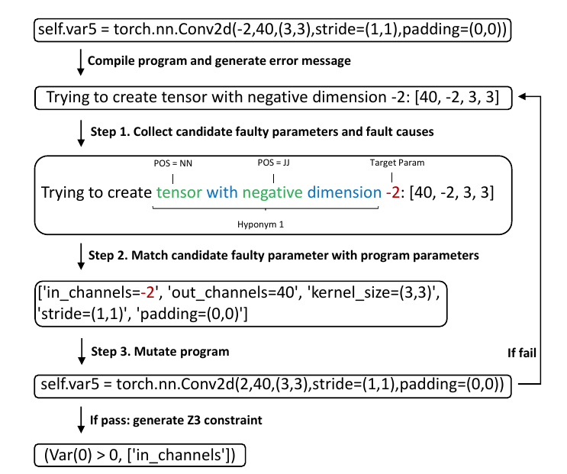
SOAR: Error Message Understanding
Detailed pipeline of pruning search space with error messages
24/05/2021
SOAR: A Synthesis Approach for Open-Source API Refactoring

Slide 20
Benchmarks
Evaluated SOAR on 40 benchmarks from two domains:
20 tasks from TensorFlow to PyTorch
20 tasks from dplyr (R) to pandas (Python)
Migrations tasks from TensorFlow to PyTorch correspond to migrating a network with 3 to 44 layers, including:
Auto-encoders
VGG
AlexNet
LeNet
24/05/2021
SOAR: A Synthesis Approach for Open-Source API Refactoring

Slide 21
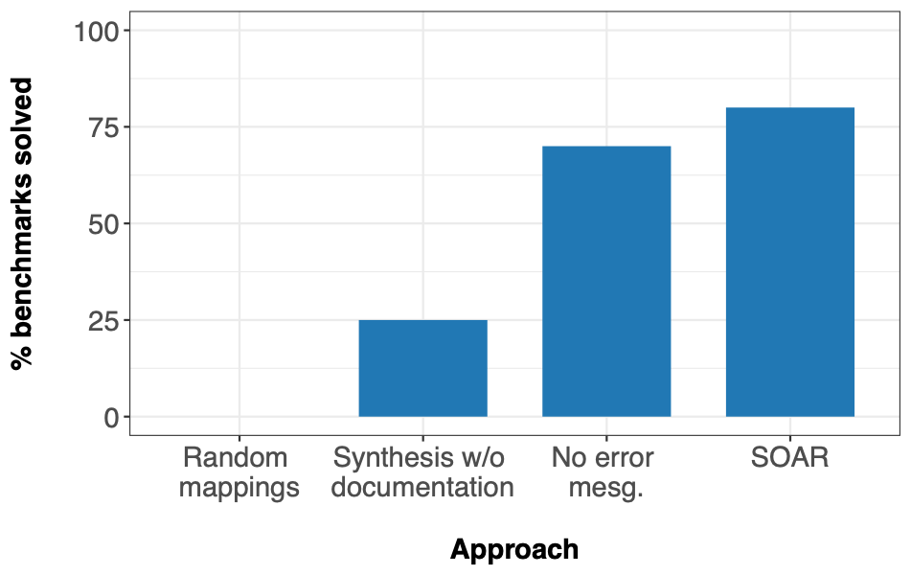
SOAR translates 80% of the benchmarks
Benchmarks solved for the TensorFlow to PyTorch task (1h timeout)
24/05/2021
SOAR: A Synthesis Approach for Open-Source API Refactoring

Slide 22
SOAR: Migration Example
SOAR: Migration Example
1 from tensorflow import keras
2
3 class AutoEncoder(keras.Model):
4 def __init__(self, **kwargs):
5 super(AutoEncoder, self).__init__()
6 self.conv1 = keras.layers.Conv2D(filters=32,
7 kernel_size=3,
8 strides=(2,2))
9
10 self.relu1 = keras.layers.ReLU()
11 self.conv2 = keras.layers.Conv2D(filters=64,
12 kernel_size=3,
13 strides=(2,2))
14
15 self.relu2 = keras.layers.ReLU()
16 self.flatt = keras.layers.Flatten()
17 self.dense = keras.layers.Dense(10)
18 self.dense = keras.layers.Dense(units=1568)
19 self.relu3 = keras.layers.ReLU()
20 self.resha = keras.layers.Reshape(
21 target_shape=(7, 7, 32))
22 self.conv3 = keras.layers.Conv2DTranspose(
23 filters=64,
24 kernel_size=3,
25 strides=2)
26
27 self.relu4 = keras.layers.ReLU()
28 self.conv4 = keras.layers.Conv2DTranspose(
29 filters=32,
30 kernel_size=3,
31 strides=2)
32
33 self.relu5 = keras.layers.ReLU()
34 self.conv5 = keras.layers.Conv2DTranspose(
35 filters=1,
36 kernel_size=3,
37 strides=1)
38
39 self.relu6 = keras.layers.ReLU()
1 import torch
2
3 class AutoEncoder(torch.nn.Module):
4 def __init__(self, **kwargs):
5 super(AutoEncoder, self).__init__()
6 self.many_0 = lambda x: x.permute(0, 3, 1, 2)
7 self.var816 = torch.nn.Conv2d(32, 32, (3, 3),
8 stride=(2, 2),
9 padding=(0, 0))
10 self.var817 = torch.nn.ReLU()
11 self.many_1 = lambda x: x.permute(0, 1, 3, 2)
12 self.var1528 = torch.nn.Conv2d(32, 64, (3, 3),
13 stride=(2, 2),
14 padding=(0, 0))
15 self.var1529 = torch.nn.ReLU()
16 self.var1530 = lambda x: torch.flatten(x, 1)
17 self.var1710 = torch.nn.Linear(64, 10)
18 self.var1801 = torch.nn.Linear(10, 1568)
19 self.var1802 = torch.nn.ReLU()
20 self.many_2 = lambda x: x.view(10, 7, 7, 32)
21
22 self.many_3 = lambda x: x.permute(0, 3, 1, 2)
23 self.var5089 = torch.nn.ConvTranspose2d(32, 64,
24 (3,3),
25 stride=(2, 2),
26 padding=(0, 0))
27 self.var5090 = torch.nn.ReLU()
28 self.many_4 = lambda x: x.permute(0, 1, 3, 2)
29 self.var7498 = torch.nn.ConvTranspose2d(64, 32,
30 (3, 3),
31 stride=(2, 2),
32 padding=(0, 0))
33 self.var7499 = torch.nn.ReLU()
34 self.many_5 = lambda x: x.permute(0, 1, 3, 2)
35 self.var8396 = torch.nn.ConvTranspose2d(32, 1,
36 (3, 3),
37 stride=(1, 1),
38 padding=(0, 0))
39 self.var8397 = torch.nn.ReLU()

Slide 23
SOAR: Migration Example
SOAR: Migration Example
1 from tensorflow import keras
2
3 class AutoEncoder(keras.Model):
4 def __init__(self, **kwargs):
5 super(AutoEncoder, self).__init__()
6 self.conv1 = keras.layers.Conv2D(filters=32,
7 kernel_size=3,
8 strides=(2,2))
9
10 self.relu1 = keras.layers.ReLU()
11 self.conv2 = keras.layers.Conv2D(filters=64,
12 kernel_size=3,
13 strides=(2,2))
14
15 self.relu2 = keras.layers.ReLU()
16 self.flatt = keras.layers.Flatten()
17 self.dense = keras.layers.Dense(10)
18 self.dense = keras.layers.Dense(units=1568)
19 self.relu3 = keras.layers.ReLU()
20 self.resha = keras.layers.Reshape(
21 target_shape=(7, 7, 32))
22 self.conv3 = keras.layers.Conv2DTranspose(
23 filters=64,
24 kernel_size=3,
25 strides=2)
26
27 self.relu4 = keras.layers.ReLU()
28 self.conv4 = keras.layers.Conv2DTranspose(
29 filters=32,
30 kernel_size=3,
31 strides=2)
32
33 self.relu5 = keras.layers.ReLU()
34 self.conv5 = keras.layers.Conv2DTranspose(
35 filters=1,
36 kernel_size=3,
37 strides=1)
38
39 self.relu6 = keras.layers.ReLU()
1 import torch
2
3 class AutoEncoder(torch.nn.Module):
4 def __init__(self, **kwargs):
5 super(AutoEncoder, self).__init__()
6 self.many_0 = lambda x: x.permute(0, 3, 1, 2)
7 self.var816 = torch.nn.Conv2d(32, 32, (3, 3),
8 stride=(2, 2),
9 padding=(0, 0))
10 self.var817 = torch.nn.ReLU()
11 self.many_1 = lambda x: x.permute(0, 1, 3, 2)
12 self.var1528 = torch.nn.Conv2d(32, 64, (3, 3),
13 stride=(2, 2),
14 padding=(0, 0))
15 self.var1529 = torch.nn.ReLU()
16 self.var1530 = lambda x: torch.flatten(x, 1)
17 self.var1710 = torch.nn.Linear(64, 10)
18 self.var1801 = torch.nn.Linear(10, 1568)
19 self.var1802 = torch.nn.ReLU()
20 self.many_2 = lambda x: x.view(10, 7, 7, 32)
21
22 self.many_3 = lambda x: x.permute(0, 3, 1, 2)
23 self.var5089 = torch.nn.ConvTranspose2d(32, 64,
24 (3,3),
25 stride=(2, 2),
26 padding=(0, 0))
27 self.var5090 = torch.nn.ReLU()
28 self.many_4 = lambda x: x.permute(0, 1, 3, 2)
29 self.var7498 = torch.nn.ConvTranspose2d(64, 32,
30 (3, 3),
31 stride=(2, 2),
32 padding=(0, 0))
33 self.var7499 = torch.nn.ReLU()
34 self.many_5 = lambda x: x.permute(0, 1, 3, 2)
35 self.var8396 = torch.nn.ConvTranspose2d(32, 1,
36 (3, 3),
37 stride=(1, 1),
38 padding=(0, 0))
39 self.var8397 = torch.nn.ReLU()

Slide 24
+
SOAR: Migration Example
1 from tensorflow import keras
2
3 class AutoEncoder(keras.Model):
4 def __init__(self, **kwargs):
5 super(AutoEncoder, self).__init__()
6 self.conv1 = keras.layers.Conv2D(filters=32,
7 kernel_size=3,
8 strides=(2,2))
9
10 self.relu1 = keras.layers.ReLU()
11 self.conv2 = keras.layers.Conv2D(filters=64,
12 kernel_size=3,
13 strides=(2,2))
14
15 self.relu2 = keras.layers.ReLU()
16 self.flatt = keras.layers.Flatten()
17 self.dense = keras.layers.Dense(10)
18 self.dense = keras.layers.Dense(units=1568)
19 self.relu3 = keras.layers.ReLU()
20 self.resha = keras.layers.Reshape(
21 target_shape=(7, 7, 32))
22 self.conv3 = keras.layers.Conv2DTranspose(
23 filters=64,
24 kernel_size=3,
25 strides=2)
26
27 self.relu4 = keras.layers.ReLU()
28 self.conv4 = keras.layers.Conv2DTranspose(
29 filters=32,
30 kernel_size=3,
31 strides=2)
32
33 self.relu5 = keras.layers.ReLU()
34 self.conv5 = keras.layers.Conv2DTranspose(
35 filters=1,
36 kernel_size=3,
37 strides=1)
38
39 self.relu6 = keras.layers.ReLU()
1 import torch
2
3 class AutoEncoder(torch.nn.Module):
4 def __init__(self, **kwargs):
5 super(AutoEncoder, self).__init__()
6 self.many_0 = lambda x: x.permute(0, 3, 1, 2)
7 self.var816 = torch.nn.Conv2d(32, 32, (3, 3),
8 stride=(2, 2),
9 padding=(0, 0))
10 self.var817 = torch.nn.ReLU()
11 self.many_1 = lambda x: x.permute(0, 1, 3, 2)
12 self.var1528 = torch.nn.Conv2d(32, 64, (3, 3),
13 stride=(2, 2),
14 padding=(0, 0))
15 self.var1529 = torch.nn.ReLU()
16 self.var1530 = lambda x: torch.flatten(x, 1)
17 self.var1710 = torch.nn.Linear(64, 10)
18 self.var1801 = torch.nn.Linear(10, 1568)
19 self.var1802 = torch.nn.ReLU()
20 self.many_2 = lambda x: x.view(10, 7, 7, 32)
21
22 self.many_3 = lambda x: x.permute(0, 3, 1, 2)
23 self.var5089 = torch.nn.ConvTranspose2d(32, 64,
24 (3,3),
25 stride=(2, 2),
26 padding=(0, 0))
27 self.var5090 = torch.nn.ReLU()
28 self.many_4 = lambda x: x.permute(0, 1, 3, 2)
29 self.var7498 = torch.nn.ConvTranspose2d(64, 32,
30 (3, 3),
31 stride=(2, 2),
32 padding=(0, 0))
33 self.var7499 = torch.nn.ReLU()
34 self.many_5 = lambda x: x.permute(0, 1, 3, 2)
35 self.var8396 = torch.nn.ConvTranspose2d(32, 1,
36 (3, 3),
37 stride=(1, 1),
38 padding=(0, 0))
39 self.var8397 = torch.nn.ReLU()

Slide 25

Final Remarks
Published at ICSE’21 (Ni, A., Ramos, D., Yang, A. Z., Lynce, I., Manquinho, V., Martins, R., & Le Goues, C. (2021, May).
Novel approach for automatic API refactoring:
Requires no training data
Leverages API documentation and error messages
Guarantees that migrated code passes all test cases
Language agnostic
Open-source: https://github.com/danieltrt/SOAR/
Replication pkg: https://zenodo.org/record/4452730
24/05/2021
SOAR: A Synthesis Approach for Open-Source API Refactoring

